Slide 1
Data Mining, ID2222
Homework 5
K-way Graph Partitioning Using JaBeJa
Group 20: Frano Rajic, Ivan Stresec

Slide 2
JaBeJa algorithm
Heuristic algorithm
Proposed by F. Rahimian, et al. in the paper JA-BE-JA: A Distributed Algorithm for Balanced Graph Partitioning
Combines local search with simulated annealing

Slide 3
Implementation
Java source code
Bash and Python scripts
used code scaffolding given on github
wrote three versions of JaBeJa
v1: task 1 + restarts
v2: task 2
v3: bonus task

Slide 4
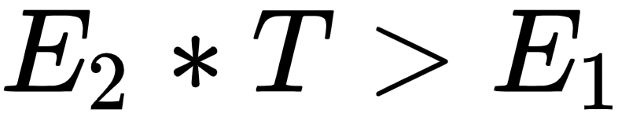
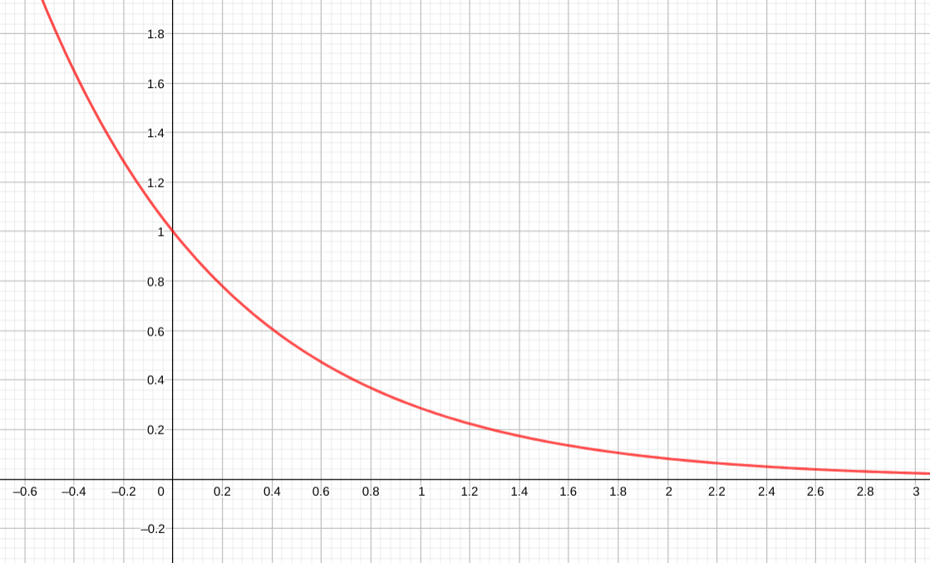
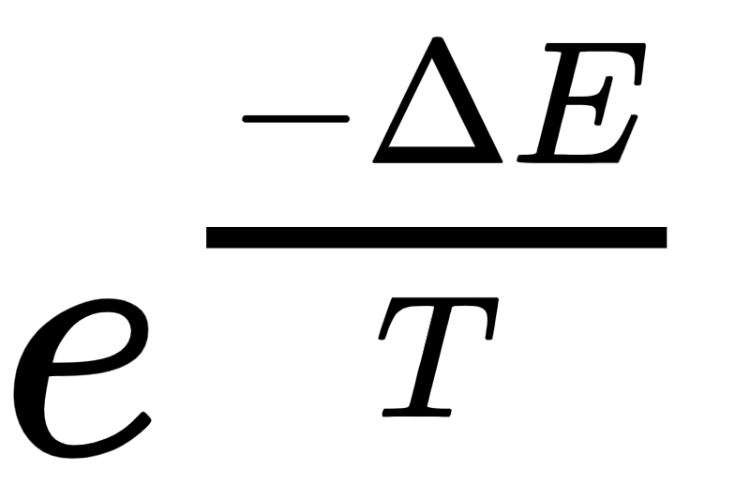
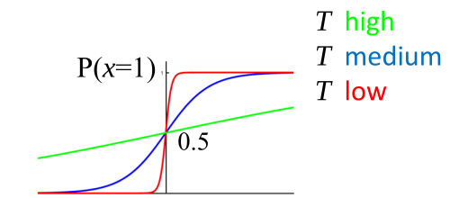
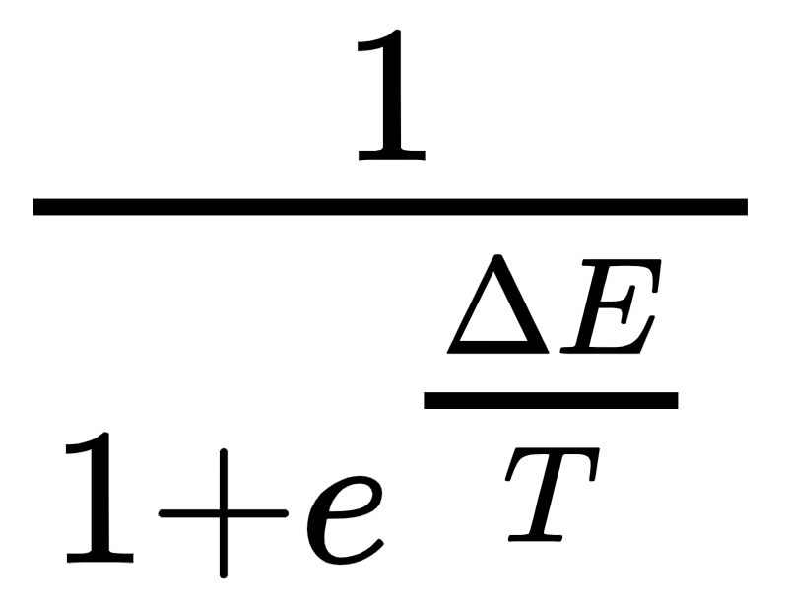
Implementation
v1
linear decrease in the temperature
v2
exponential decrease in the temperature
acceptance probability:
v3 (bonus)
exponential decrease in the temperature
acceptance probability:

Slide 5
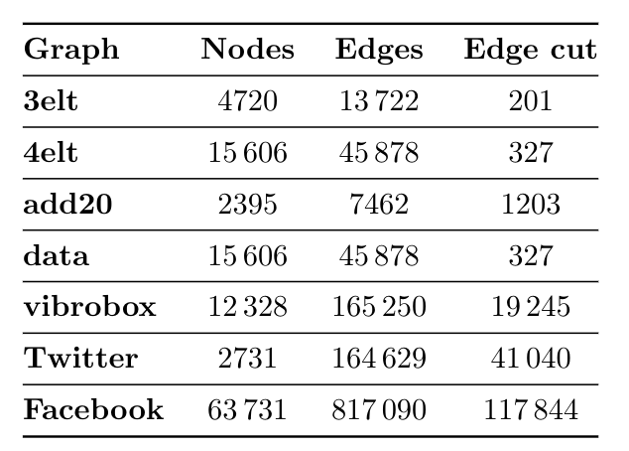
Datasets

Slide 6
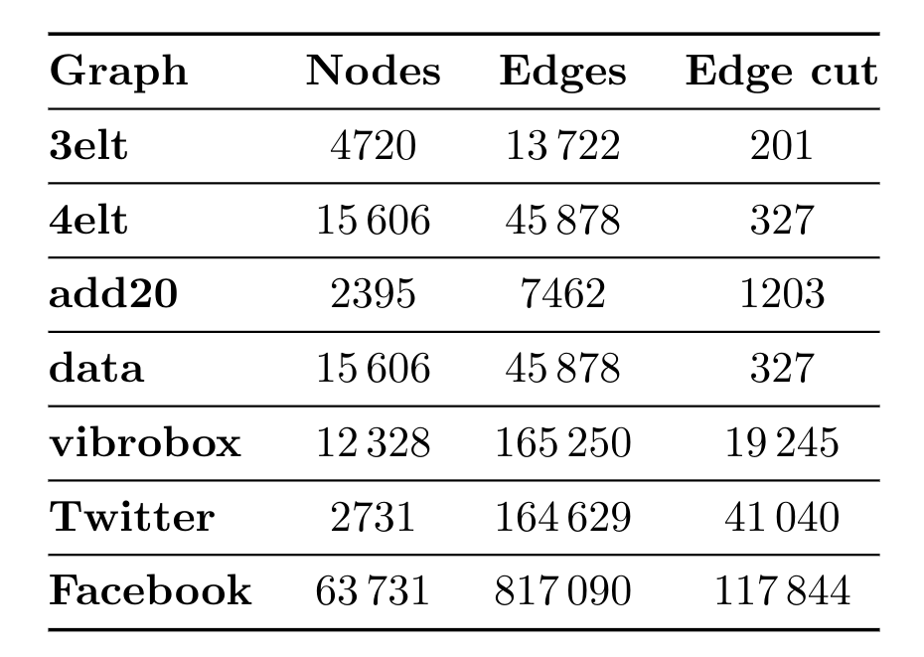
Datasets

Slide 7
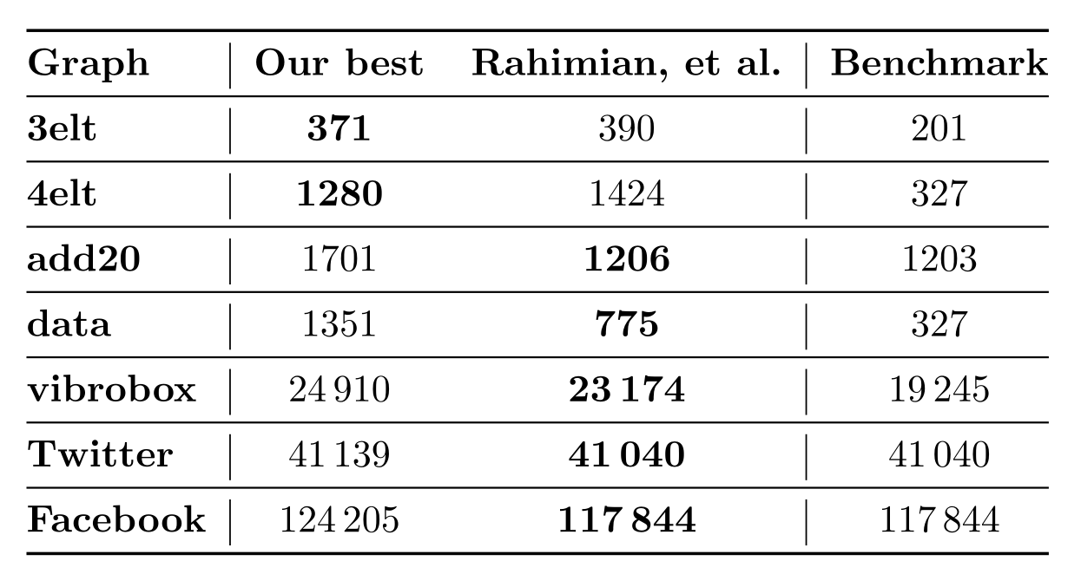
Results summary
For all results: RNSS=3, URSS=6, delta=0.003, n_partitions=4
Temperature and Alpha were varied

Slide 8
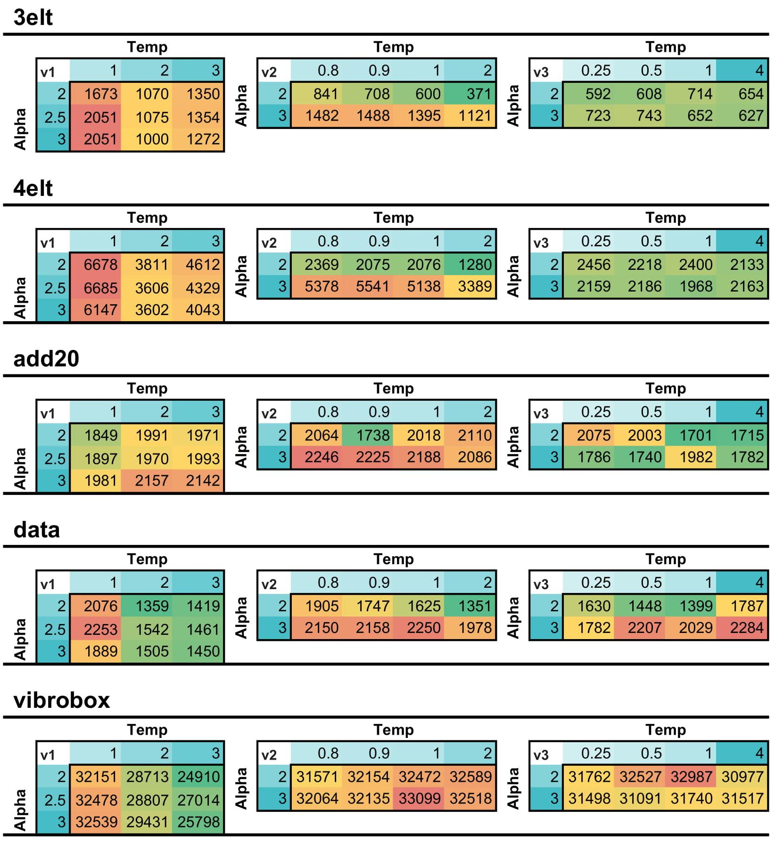
Results

Slide 9
Results

Slide 10
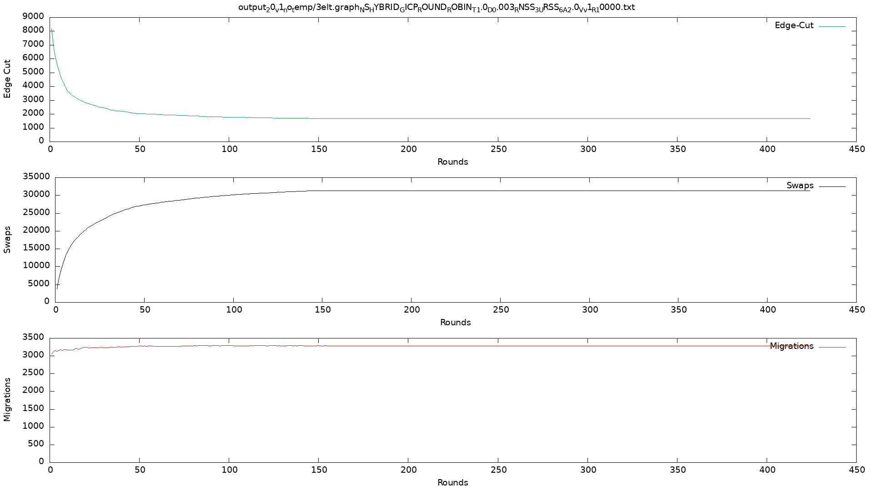
v1 w/o SA

Slide 11
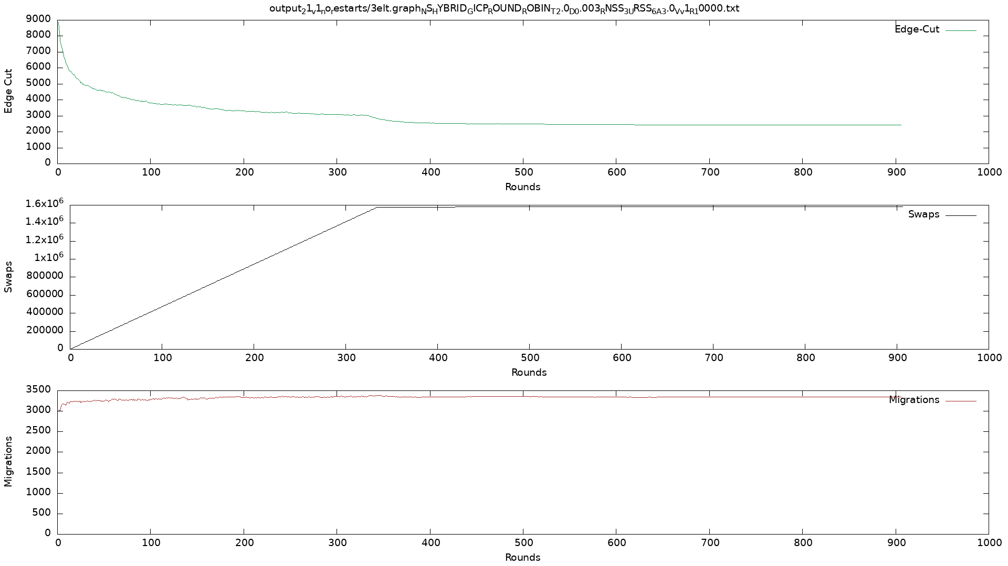
v1 w/o restarts

Slide 12
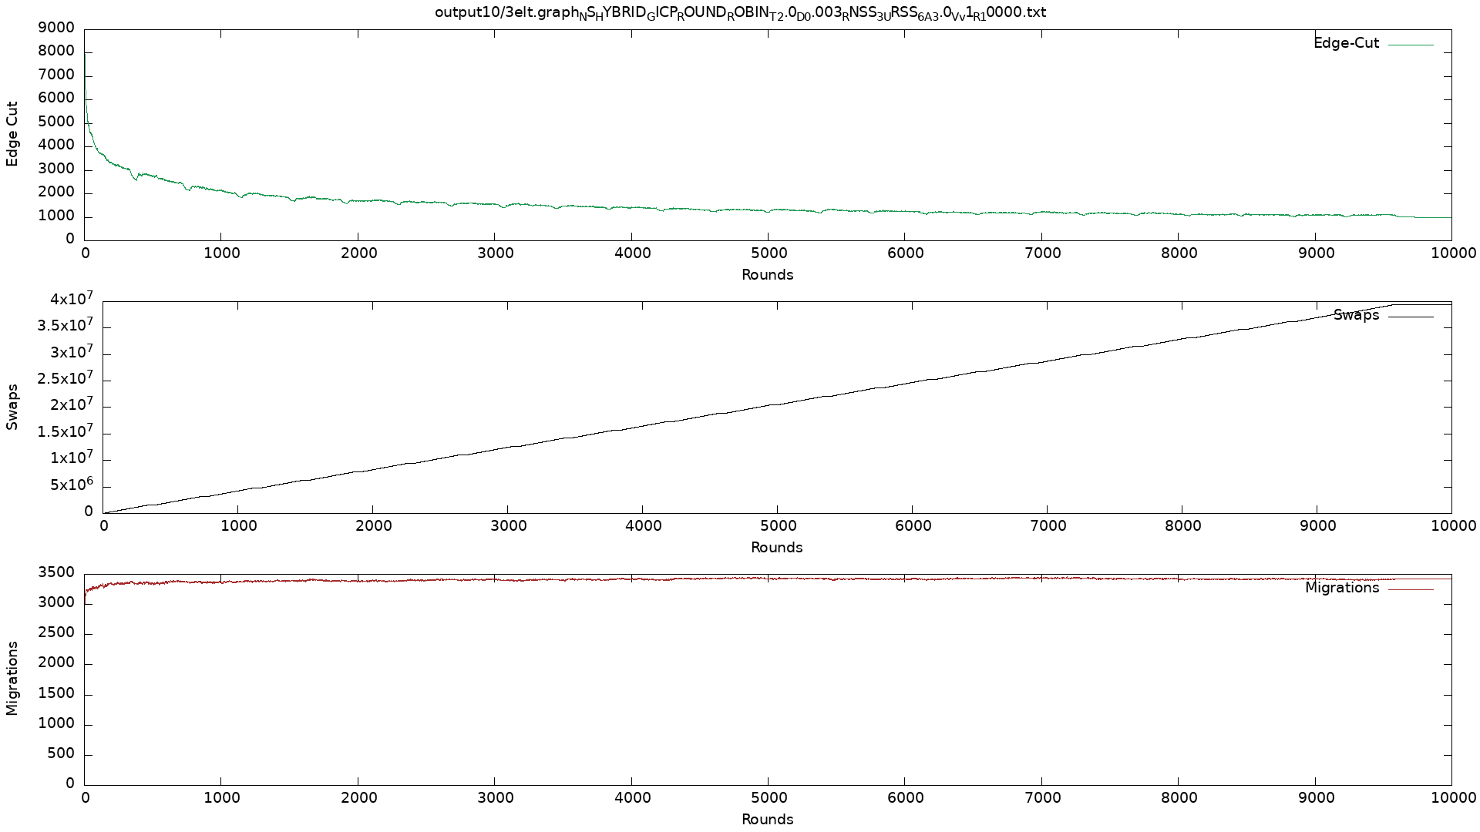
v1

Slide 13
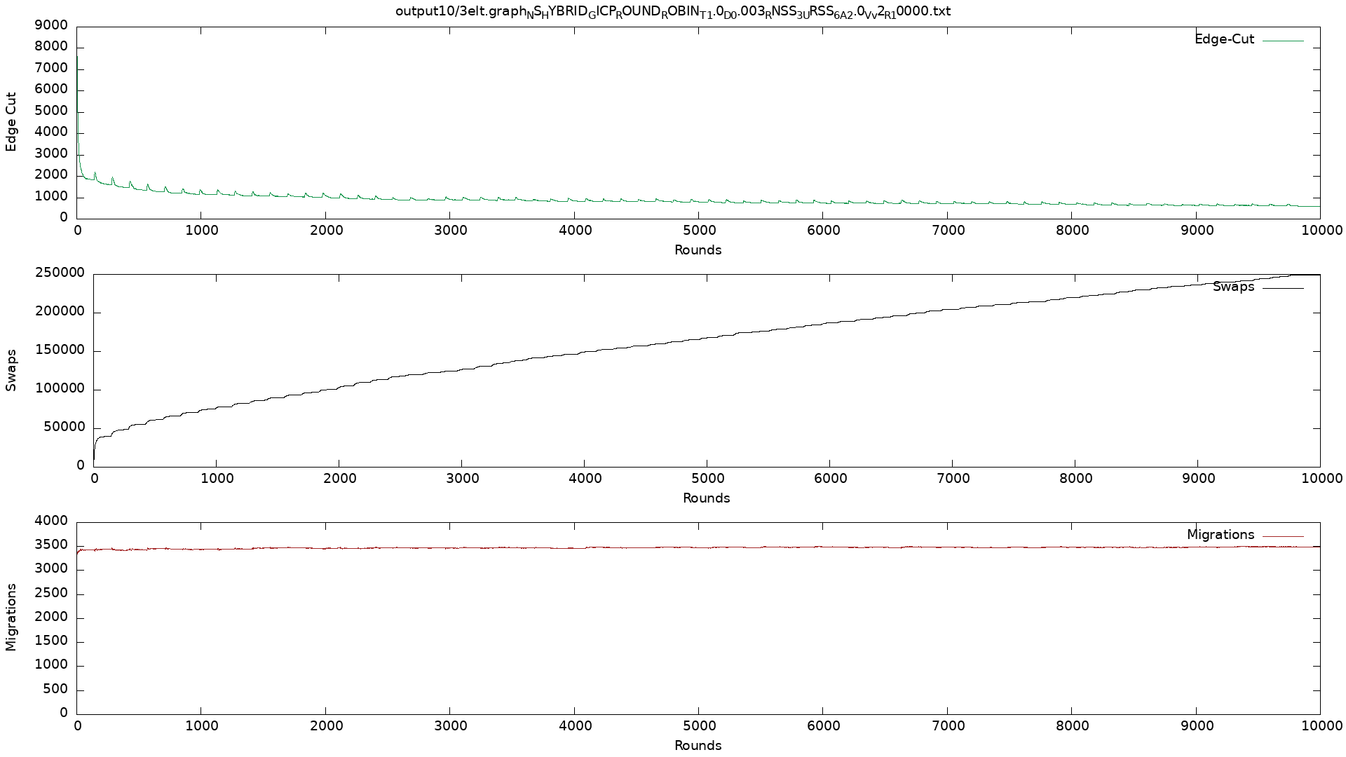
v2

Slide 14
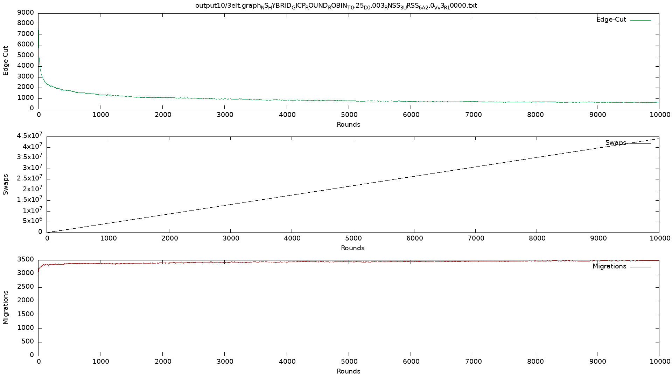
v3

